Slide 1
Chapter 5
Configuring the RMAN Environment

Slide 2
Objectives
Show command to see existing settings
Configure command to change settings
Backing up the controlfile
Recovering the controlfile
Specifying retention periods
Configuring backup device types
Configuring the default backup type
Using compression

Slide 3
Objectives (cont.)
Configuring multiple backup copies
Configuring backup optimization
Specifying backup piece file names
Tagging RMAN backups
Configuring RMAN channels
Creating backup retention policy
Configuring backup size limits

Slide 4

Rman Configuration Settings
Use ‘show’ command
  To see a particular RMAN configuration setting
  Always stored in target database controlfile
  ‘show all’ will display all settings
  Also see V$RMAN_CONFIGURATION view

Slide 5
Rman Settings (cont.)
Key parameters of note:
  Configure retention policy to redundancy 1
  Configure backup optimization off
  Configure default device type to disk
  Configure controlfile autobackup off
  Configure device type disk parallelism 1 backup type to backupset
  Configure datafile backup copies for device type disk to 1
  Configure maxsetsize to unlimited
  Configure encryption for database off

Slide 6
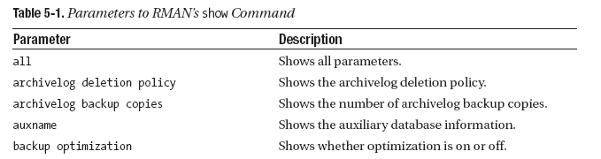
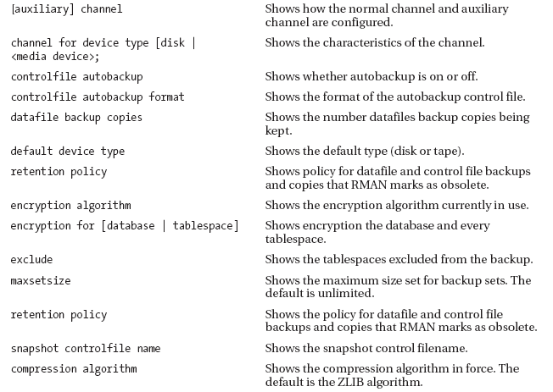
Rman Settings (cont.)

Slide 7
Configuring RMAN
Use ‘configure’ command
Changes settings for:
  Backup
  Restore
  Duplication
  Maintenance
Target database settings stored in controlfile
Recovery catalog stores settings for all registered databases
Database must be in mount or open state
Reset to default setting using ‘configure . . . clear’ command

Slide 8

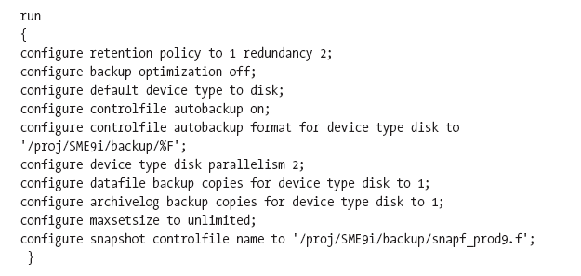
Configuring RMAN (cont.)
To change single setting:
Change multiple settings at once with ‘run’ block:

Slide 9
Automatic Controlfile Backups
Disabled by default
Oracle recommends enabling if no recovery catalog is used
Enabling ensures controlfile backup after:
  Successful completion of backup or copy command
  ‘create catalog’ command runs
  Any structural change to the database
Simplifies backup scripts
Simplifies recovery process
Also backs up server parameter file (spfile)

Slide 10
Controlfile Backups (cont.)
Examples of structural changes include:
  Adding tablespace or datafile
  Dropping datafile
  Altering a tablespace online or offline
  Adding an online redo log
  Renaming a datafile

Slide 11

Controlfile Backup Location
By default:
  Written to flashback area (if specified)
  If no flashback area, goes to:
    $ORACLE_HOME/dbs (Unix)
    $ORACLE_HOME\database (Windows)
Can specify location using ‘configure’ command

Slide 12
Recovery Steps using Controlfile
Restore of server parameter file
RMAN starts instance with restored SPFILE
RMAN restores controlfile
Controlfile is mounted
Datafiles are restored
Recover database occurs
Extra steps necessary if recovery catalog is used

Slide 13
Snapshot Controlfile
RMAN automatically creates when:
  Resynchronizing with the recovery catalog
  Making a backup of the controlfile
Needed to maintain read-consistent view of controlfile
By default:
  Written to:
    $ORACLE_HOME/dbs (Unix)
    $ORACLE_HOME\database (Windows)
  Can specify location with ‘configure’ command
  Flashback area not used

Slide 14
Specifying Retention Period
If keeping metadata in controlfile
  Use control_file-record_keep_time initialization parameter (specified in days)
  Default is seven days
  Can specify a range of 0 to 365 days
  Metadata stored in ‘reusable’ section of controlfile
  Also see V$CONTROLFILE_RECORD_SECTION

Slide 15
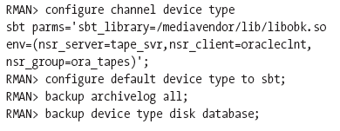
Configuring Backup Device Type
Disk is default device type
Use ‘configure’ to change device type or restore default setting
Can override at backup time

Slide 16

Configuring Default Backup Type
Default is a backup set
Can change to image copy with ‘configure’
Revert to backup set with either of the following:

Slide 17
Using Compression
Can save storage space
Reduces network traffic
Default is non-compressed backup set
Can compress for both disk and tape
Can read compressed backup set without uncompressing
You can choose compression algorithm
See V$RMAN_COMPRESSION_ALGORITHM

Slide 18
Configuring Multiple Backup Copies
Called duplexing
RMAN makes multiple copies of backup pieces
Default is one copy
Using ‘configure’ copies parameter
Cannot make duplex backups to flash recovery area
Useful to place backups on different media
All copies still within same backup set

Slide 19
Configuring Backup Optimization
By default, turned off
  Means RMAN backs up every file
Turn on with ‘configure’
When set to on, RMAN skips files already backed up
Applies to following files
  Datafiles
  Archived redo logs
  Backup sets

Slide 20
Specifying Backup Piece Filenames
Useful to make meaningful names
Accomplished with format parameter within backup command
Can also use db_file_name_convert
Restrictions may apply if using media manager
Can also use with image copies

Slide 21

Tagging RMAN Backups
Names backup for easy identification
Assign character string or ‘tag’
If none specified, RMAN assigns default tag
Can tag both backup set or image copies

Slide 22
Configuring RMAN Channels
Can be configured for automatic allocation
Can be configured manually
At least one channel must be allocated to run the following commands:
  Backup
  Restore
  Recover
  Duplicate
  Create catalog
  Validate

Slide 23
Configuring Automatic Channels
If used, channel allocation automatic for all RMAN sessions
Can configure default device type for channels
Must be a single device type (disk or tape)
Can specify degree of parallelism
Can specify maximum backup piece size
Can always override with ‘run’ block
Generic parameter settings can be set up for all automatic channels
Channel allocation differs between backup/copy commands and restore command

Slide 24
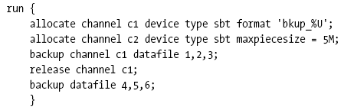
Manually Allocating Channels
Done inside a ‘run’ block
Naming a channel ‘id’ is optional
Channel ‘id’ used when reporting errors
Channels released when ‘run’ block ends
Can also be explicitly released
Example to allocate and release channels:

Slide 25
Allocating Maintenance Channel
Used for maintenance tasks:
  Change
  Delete
  Crosscheck
Can only be used at RMAN prompt (no ‘run’ block)
Not necessary if at least one default channel allocated for each device type
Example of deleting a backup:

Slide 26
Creating Backup Retention Policy
Can be specified in two ways:
  Based on time
  Based on number of copies
Any backup older than retention is marked as obsolete
Can set retention policy to ‘none’ (infinite)
If using incremental backups, retention will exceed configured retention period
Also see V$BACKUP_FILES

Slide 27
Archived Redo Log Deletion Policy
No policy used by default
Specified which archived logs eligible for deletion
Only logs in flash recovery area automatically deleted
Logs in other locations need manual deletion
Does not affect logs within backup sets

Slide 28
Configuring Backup Size Limits
For backup pieces:
  Limit via maxpiecesize parameter
  Done to accommodate limitations on storage devices
For backup sets
  Limit via maxsetsize parameter
  Done to accommodate O/S limitations
  Many factors need evaluation in determining backup set size
Cannot limit the size of image copies

